Slide 1
Digital Portfolio
STUDENT NAME : S.LILLY
REGISTER NO AND NMID : 85B1BAF7A267F1699B04926936D512D3
DEPARTMENT : B.SC.COMPUTER SCIENCE
COLLEGE : VOORHEES COLLEGE VELLORE,
UNIVERSITY : THIRUVALLUVAR UNIVERSITY.

Slide 2
PROJECT TITLE STUDENT PORTFOLIO USING FRONT END DEVELOPMENT

Slide 3


AGENDA
Problem Statement
Project Overview
End Users
Tools and Technologies
Portfolio design and Layout
Features and Functionality
Results and Screenshots
Conclusion
Github Link
3/21/2024 Annual Review

Slide 4

PROBLEM STATEMENT
"In today’s competitive job market, freshers often face challenges in effectively presenting their skills and projects. Traditional resumes limit the ability to showcase technical expertise and creativity in a clear and interactive way. To solve this problem, I have developed a personal portfolio website that highlights my skills in HTML, CSS, JavaScript, Python, and C++, while also providing an organized space to demonstrate my projects and achievements."

Slide 5

PROJECT OVERVIEW
Personal Portfolio Website – A responsive website to showcase my skills, projects, and achievements.
To-Do List Application – A task manager app to add, edit, and track daily tasks.
Student Management System – A Python-based project to manage student records and performance.
Calculator – A simple web calculator for basic arithmetic operations.
E-Commerce Website (Mini Project) – A basic online shopping platform with product listings and cart system.

Slide 6

WHO ARE THE END USERS?
Personal Portfolio Website – A responsive website to showcase my skills, projects, and achievements.
To-Do List Application – A task manager app to add, edit, and track daily tasks.
Student Management System – A Python-based project to manage student records and performance.
Calculator – A simple web calculator for basic arithmetic operations.
E-Commerce Website (Mini Project) – A basic online shopping platform with product listings and cart system.

Slide 7

TOOLS AND TECHNIQUES
1. Personal Portfolio Website
Tools: VS Code, GitHub, Chrome DevTools
Techniques: Responsive Web Design, Clean UI/UX design, Semantic HTML
2. To-Do List Application
Tools: VS Code, GitHub
Techniques: DOM Manipulation, Event Handling, Local Storage (for saving tasks)
3. Student Management System
Tools: Python IDLE / VS Code, SQLite Database
Techniques: CRUD Operations (Create, Read, Update, Delete), Data Validation, File Handling
4. Calculator
Tools: VS Code, GitHub
Techniques: JavaScript Functions, Event Listeners, Interactive UI
5. E-Commerce Website (Mini Project)
Tools: VS Code, GitHub, Browser Developer Tools
Techniques: Frontend Development, Form Handling, Cart Management, Responsive Layout

Slide 8
POTFOLIO DESIGN AND LAYOUT
Header / Navbar – Name/Logo + links (Home, About, Skills, Projects, Contact).
Hero Section – Intro (Name, Role, Tagline, Resume Button).
About Me – Short bio + career goals.
Skills – List of technical skills (HTML, CSS, JS, Python, C++).
Projects – Cards with title, description, tools, features, links (Code / Demo).
Resume (optional) – Download button.
Contact – Form + social links (LinkedIn, GitHub).
Footer – Copyright + quick links.
8

Slide 9
FEATURES AND FUNCTIONALITY
Responsive Design → Works smoothly on desktop, tablet, and mobile.
Interactive Navigation → Easy scrolling and quick access to all sections.
About Me Section → Highlights education, skills, and career goals.
Skills Showcase → Displays technical skills (HTML, CSS, JavaScript, Python, C++).
Projects Section → Detailed project cards with description, tools, techniques, and links (Code/Demo).
Resume Download → Option to download CV directly.
Contact Form → Simple form to send messages easily.
Social Media Integration → Links to LinkedIn, GitHub, and Email.
Clean UI/UX → Minimal, modern, and recruiter-friendly design.

Slide 10
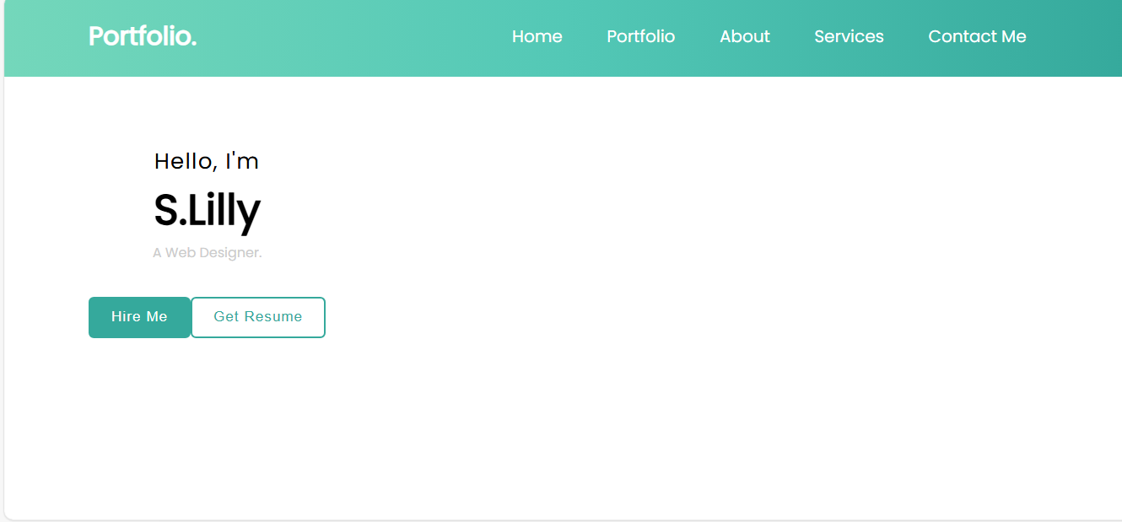

RESULTS AND SCREENSHOTS 1.
3/21/2024 Annual Review
10

Slide 11
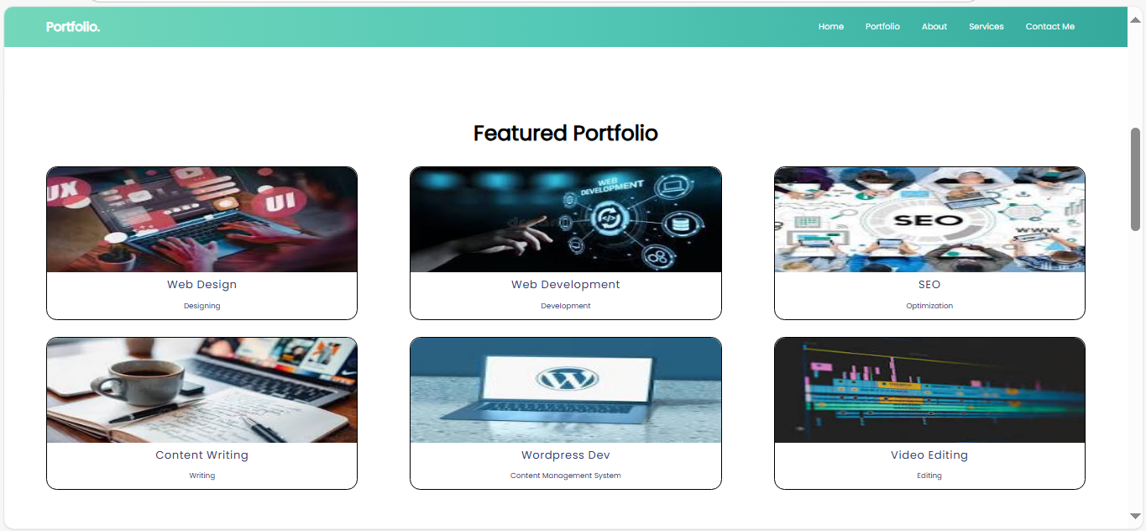
2.

Slide 12
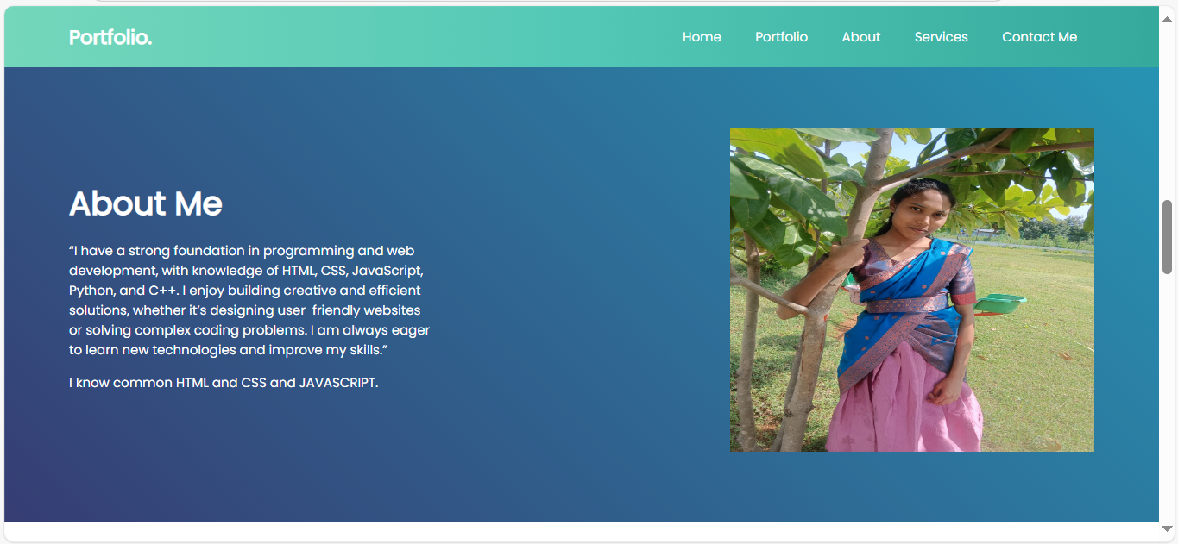
3.

Slide 13
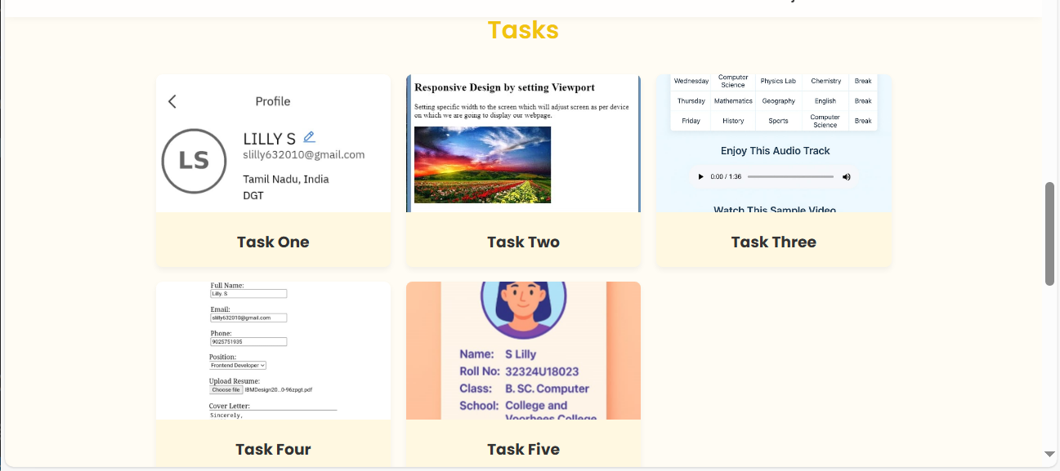
Tasks

Slide 14
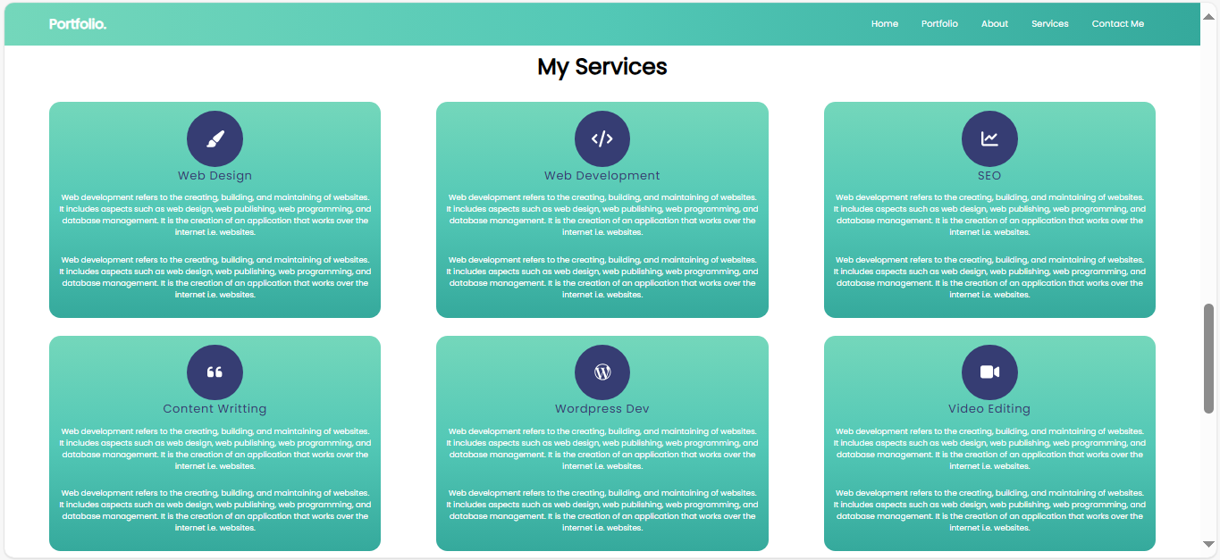
4.

Slide 15
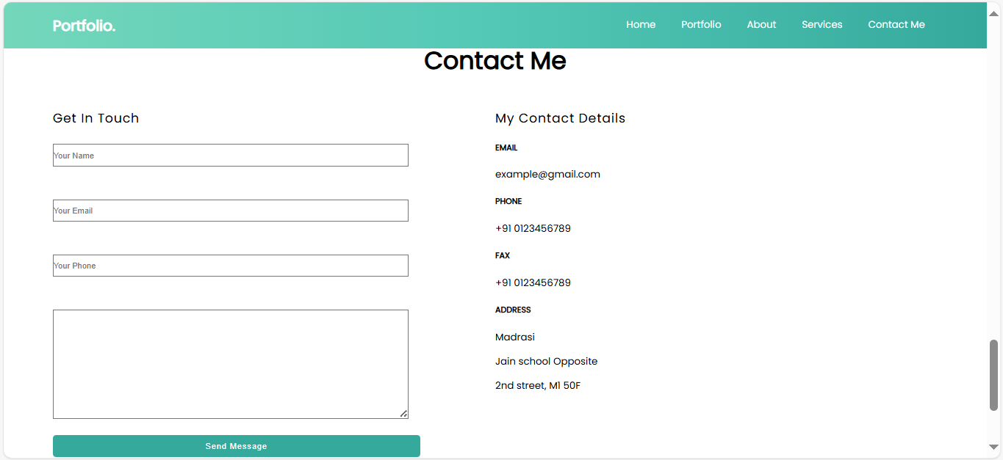
5.

Slide 16
CONCLUSION
Thank you for visiting my portfolio. This space reflects my journey as a learner and developer, showcasing my skills in HTML, CSS, JavaScript, Python, and C++. I am passionate about building creative and practical solutions while continuously improving my knowledge. I look forward to opportunities where I can apply my skills, contribute to meaningful projects, and grow as a professional.
16

